Slide 1
UML Diagrams
Bugais, Lady Kim
Domalanta, Kemp
Dumandal, Krisa Joy

Slide 2
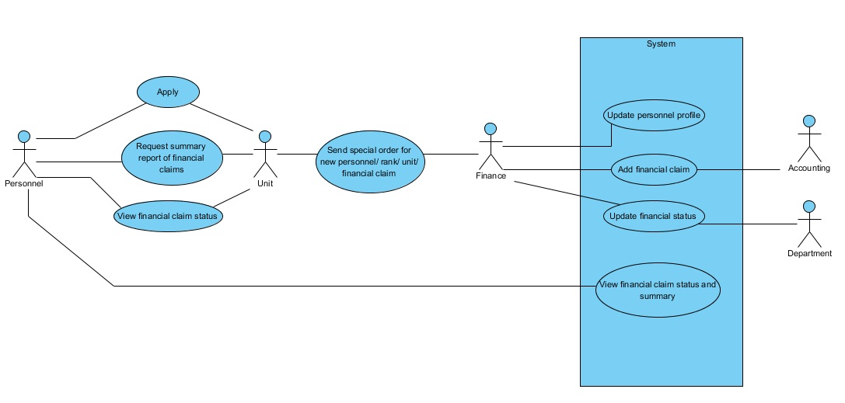
Use Case Diagram

Slide 3
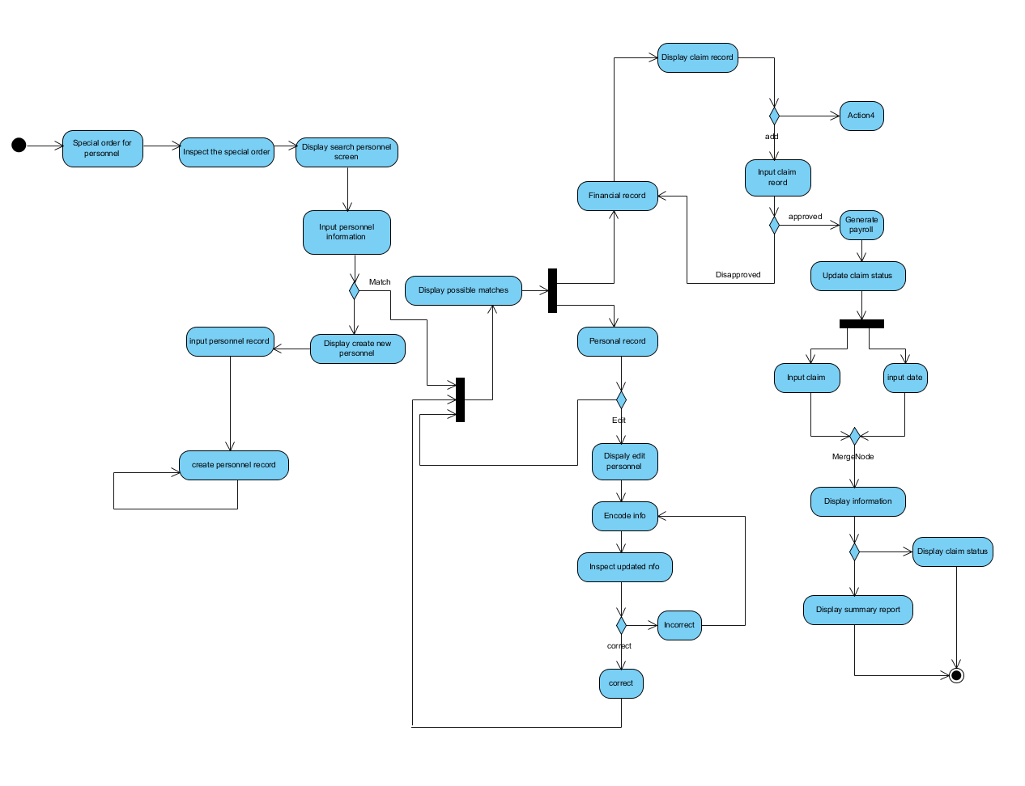
Activity Diagram

Slide 4
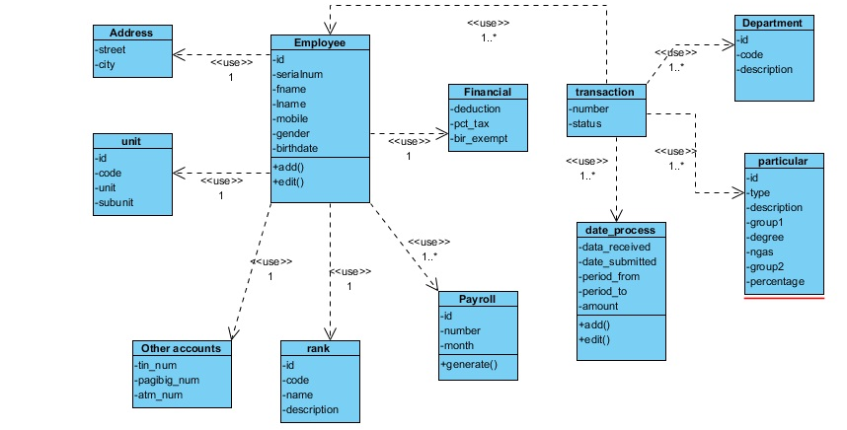
Class Diagram

Slide 5
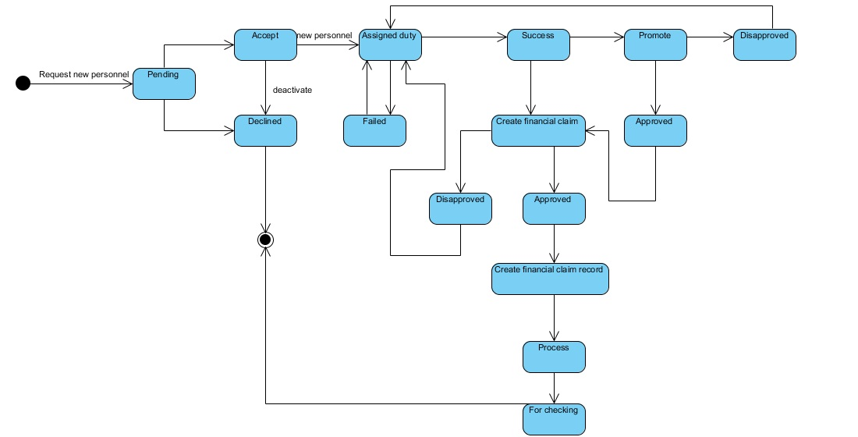
State Transition Diagram

Slide 6
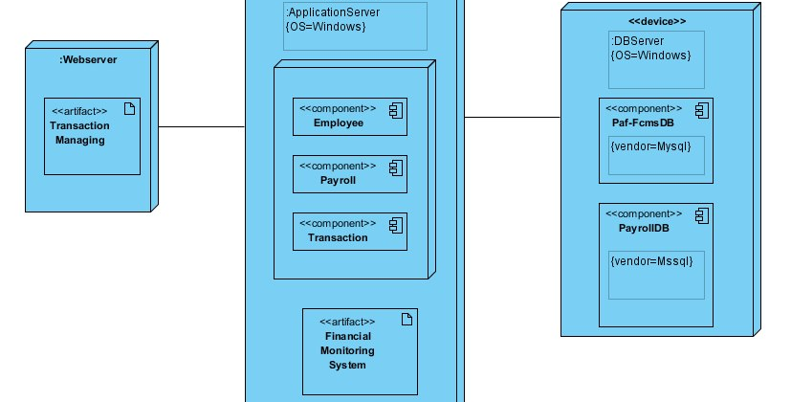
Deployment Diagram

Slide 7
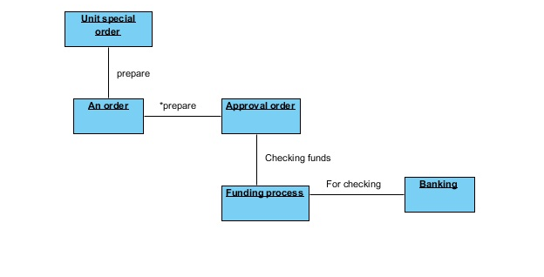
Interaction Diagram

Slide 8
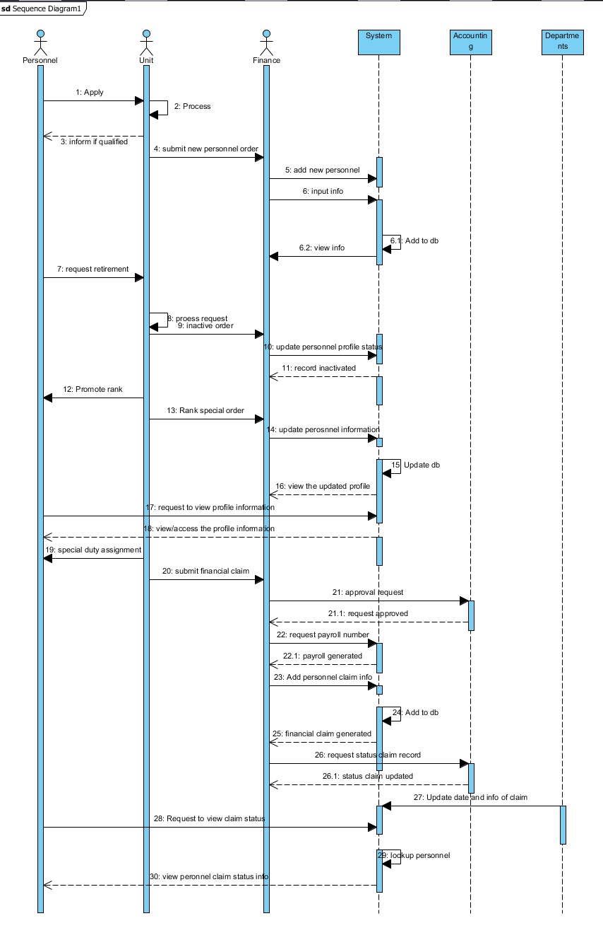
Sequence Diagram

Slide 9
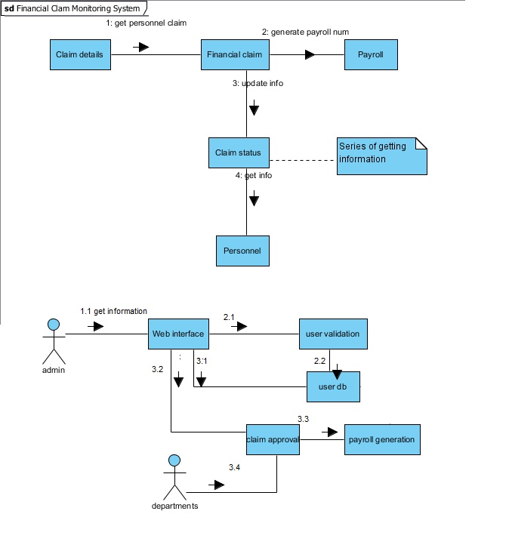
Communication Diagram

Slide 10
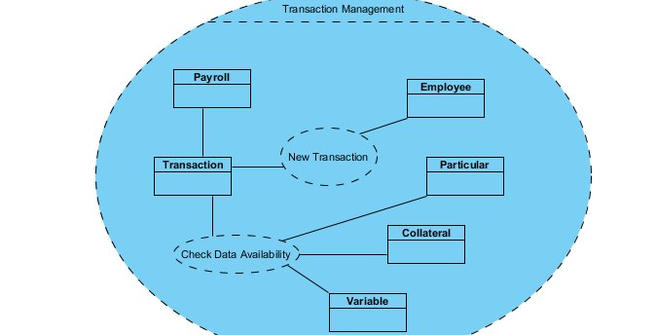
Composite structure

Slide 11
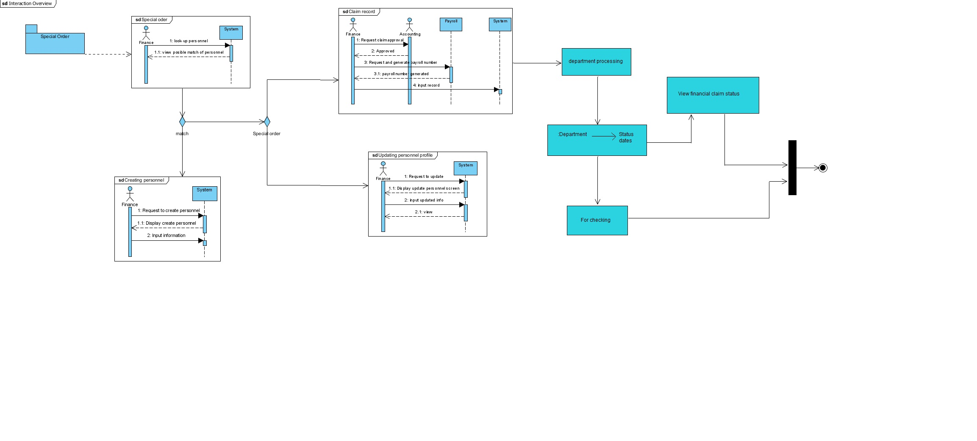
Interaction overview

Slide 12
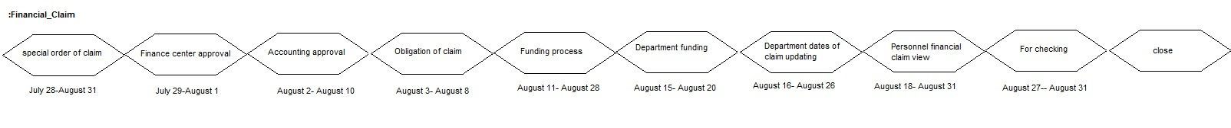
Timing Diagram

Slide 13
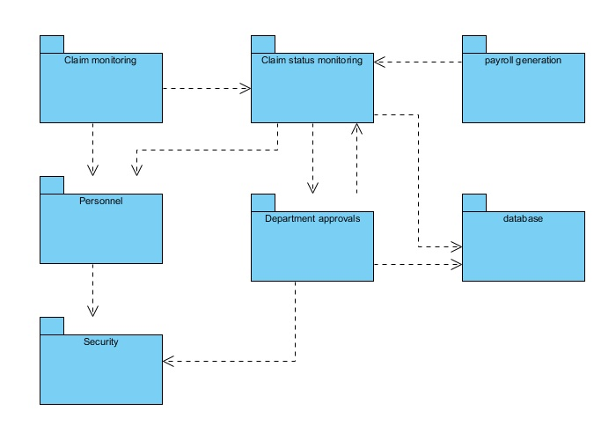
Package Diagram

Slide 14
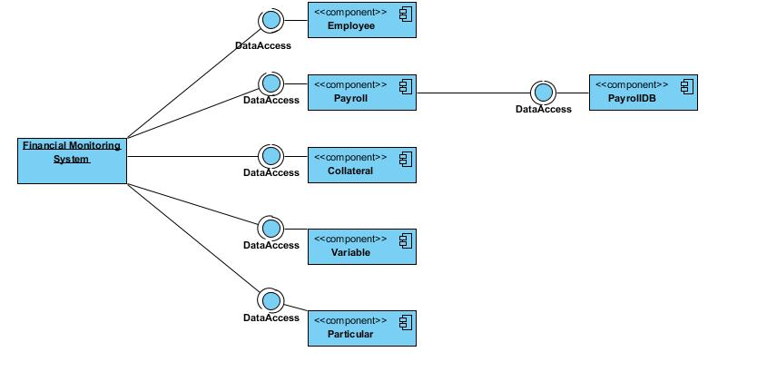
Component Diagram

